Slide 1
REST Applications in .NET
Representational State Transfer
Ben Dewey
twentySix New York
http://bendewey.wordpress.com

Slide 2
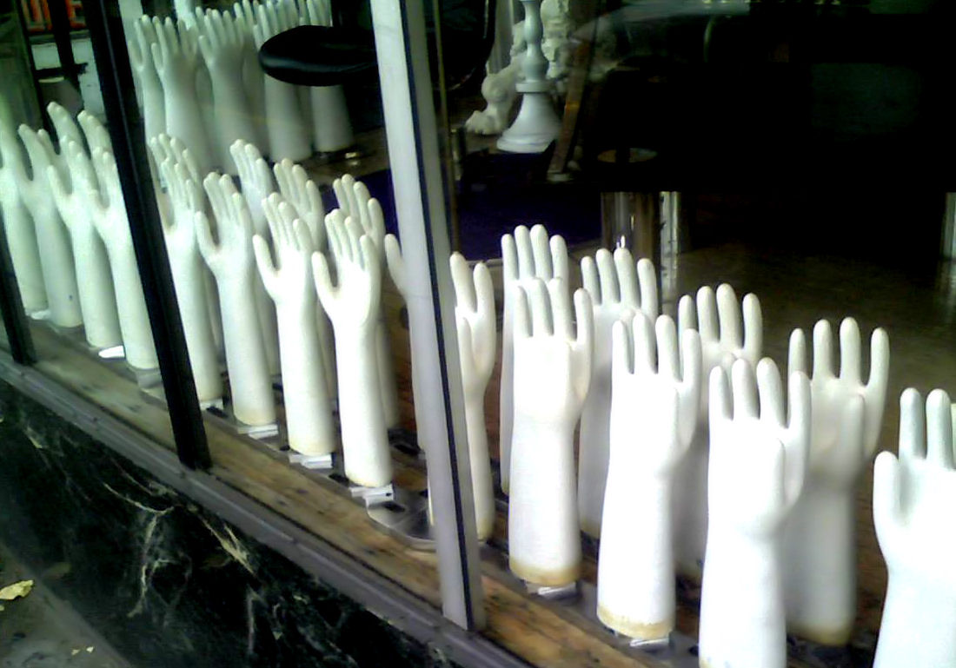

Slide 3
Overview
What is REST
Rules and Guidelines
Hosting a REST Service in .NET
Consuming a REST Service with .NET
Samples
Discussion

Slide 4
What is REST?
Roy Fielding
http://www.ics.uci.edu/~fielding/pubs/dissertation/top.htm
Client-Server
Stateless
Cachable
Layered System
Code-on-demand (optional)

Slide 5
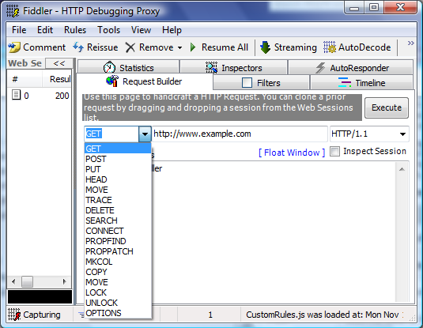
HTTP Methods

Slide 6
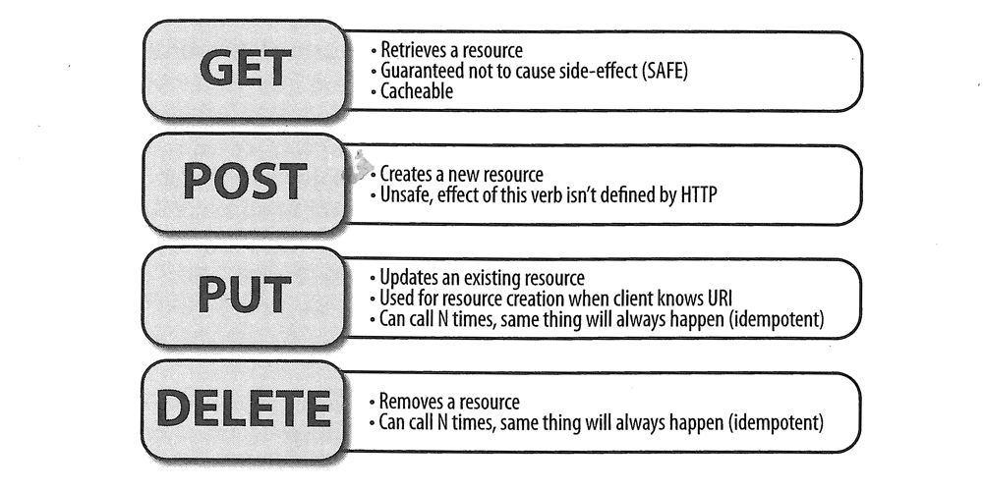
HTTP Methods
Courtesy of RESTful .NET by Jon Flanders

Slide 7
HTTP Status Codes
Status Range | Description | Examples
100 | Informational | 100 Continue
200 | Successful | 200 OK
201 | Created
202 | Accepted
300 | Redirection | 301 Moved Permanently
304 | Not Modified
400 | Client error | 401 Unauthorized
402 | Payment Required
404 | Not Found
405 | Method Not Allowed
500 | Server error | 500 Internal Server Error
501 | Not Implemented

Slide 8
HTTP Messages
GET / HTTP/1.1
User-Agent: Fiddler
Host: localhost:9999
HTTP/1.1 200 OK
Content-Length: 256
Content-Type: application/xml; charset=utf-8
Server: Microsoft-HTTPAPI/2.0
Date: Tue, 17 Nov 2009 02:11:11 GMT
<?xml version="1.0" encoding="utf-8"?>
<Data />

Slide 9
URIs (Uniform Resource Identifiers)
RPC (SOAP) Interface
http://example.com/CarsService/getYears
http://example.com/CarsService/getMakes
http://example.com/CarsService/getAutomobile
http://example.com/CarsService/updateAutomobile
http://example.com/CarsService/deleteAutomobile

Slide 10
URIs (Uniform Resource Identifiers)
RESTful Interface
No need to distinguish get/update/delete, that’s what the HTTP Method is for
Collection
http://example.com/2008/Honda/
Resource
http://example.com/2008/Honda/Civic/2.0L-V6

Slide 11
Return Types
XML
XHTML
ATOM Publishing Protocol
RSS
Custom (should contain hyperlinks)
JSON
Custom

Slide 12
WADL
Web Application
Definition Language
WSDL for REST

Slide 13
WADL

Slide 14
Hosting REST in .NET
Windows Communication Foundation (WCF)
Web* additions in .NET 3.5
WebHttpBinding, WebOperationContext, WebGet/Invoke Attributes, etc
UriTemplates for Routing
REST Starter Kit Preview 2
WCF Hosting (Console, IIS, etc)
ASP.NET MVC
JsonResults and XmlResults for serialization
System.Web.Routing engine for routing

Slide 15
Hosting WCF (Catch-All Controller)
[ServiceContract]
public interface IAutomobileService
{
[OperationContract]
[WebGet(UriTemplate = "*")]
Message Get();
[OperationContract]
[WebInvoke(Method = "PUT", UriTemplate = "*")]
Message Put(Message data);
}

Slide 16
Hosting WCF (UriTemplates)
[ServiceContract]
public interface IAutomobileService
{
[OperationContract]
[WebGet(UriTemplate = "/{year}/{make}/{model}/{engine}")]
Automobiles GetAutomobiles(string year, string make,
string model, string engine);
}

Slide 17
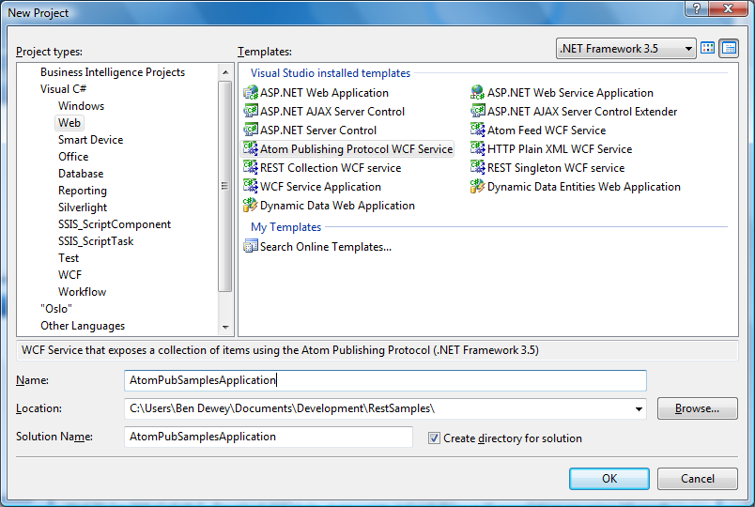
Hosting WCF (REST Starter Kit)

Slide 18
Hosting MVC
routes.MapRoute(
"Default",
"{year}/{make}/{model}/{engine}",
new { controller = "Main", action = "Main", year = "",
make = "", model = "", engine = "" }
);
public ActionResult Main(int? year, string make,
string model, string engine)
{
if (!year.HasValue)
{
return Xml(AutomobileRepository.GetYears());
}
else { /* … */ }
}

Slide 19
Consuming REST in .NET
WebRequest
WCF Interface Mocking
HttpClient
Ships with REST Starter Kit Preview 2

Slide 20
WebRequest
var httpRequest = (HttpWebRequest)WebRequest.Create(
"http://localhost/service.svc");
using (var upStream = httpRequest.GetRequestStream())
{
// some complicated logic to create the message
}
var response = httpRequest.GetResponse();
using (var downStream = response.GetResponseStream())
{
// some complicated logic to handle the response message.
}

Slide 21
WCF Interface Mock
[ServiceContract]
public interface ITwitterService
{
[OperationContract]
[WebInvoke(UriTemplate = "/friendships/create/{user}.xml")]
TwitterUser CreateFriendship(string user);
}
using (var factory = new WebChannelFactory<ITwitterService>(
new Uri("http://www.twitter.com/")))
{
factory.Credentials.UserName.UserName = username;
factory.Credentials.UserName.Password = password;
var proxy = factory.CreateChannel();
var user = proxy.CreateFriendship("userToFollow");
}

Slide 22
HttpClient
using (var client = new HttpClient())
{
var postData = new StringContent("");
var url = "http://www.twitter.com/friendship/create/userToFollow.xml";
var user = client.Post(url, postData)
.EnsureStatusIsSuccessful() .Content.ReadAsXmlSerializable<TwitterUser>();
}

Slide 23
Samples/Demos

Slide 24
Resources
Roy Fielding’s Dissertation
http://www.ics.uci.edu/~fielding/pubs/dissertation/rest_arch_style.htm
REST in Windows Communication Foundation (WCF)
http://msdn.microsoft.com/en-us/netframework/cc950529.aspx
RESTful .NET by Jon Flanders
http://oreilly.com/catalog/9780596519209/
REST on Wikipedia
http://en.wikipedia.org/wiki/REST
A Guide to Designing and Building RESTful Web Services with WCF 3.5
http://msdn.microsoft.com/en-us/library/dd203052.aspx
Creating a RESTful Web Service Using ASP.Net MVC
http://shouldersofgiants.co.uk/Blog/post/2009/09/05/...RESTful...MVC...
* These slides will be posted on my blog (http://bendewey.wordpress.com)

Slide 25
Discussion
SOAP vs REST
MVC vs WCF
ATOM/RSS
Easiest for JavaScript Consumption
OAUTH WRAP

Slide 26
Session Wrap-Up
Thoughts and Impressions
Positives and Deltas
Discussion of Topics for Upcoming Meetings

