Slide 1
Building a Rich Internet Application with jQuery
Fill this space with whatever you want (graphic, logo, whatever)
Ben Dewey
twentysix New York
http://www.bendewey.com/blog
http://twitter.com/bendewey

Slide 2


We thank the following companies for their gracious sponsorship
Platinum Sponsors
Gold Sponsor

Slide 3
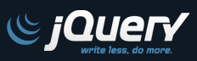
Assumptions
Basic knowledge of
  .NET
  HTML
  CSS
  Javascript
Who has used jQuery?

Slide 4
Overview
What is jQuery
Basic jQuery Demos
Creating a RESTful WCF Service
AJAX calls with WCF and jQuery
Wrap-up/Q&A

Slide 5
What is jQuery
“jQuery is a fast and concise JavaScript Library that simplifies HTML document traversing, event handling, animating, and Ajax interactions for rapid web development. jQuery is designed to change the way that you write JavaScript.”
Alleviates the pains of cross browser development
For this presentation we’re using jQuery version 1.4.2

Slide 6
Features in jQuery
Selectors
  No more getElementById()
Wrapped Set Operations
Events
  Keeps event binding out of markup
Plugin Extensibility
  jQuery UI Project
  ThemeRoller

Slide 7
Selectors in jQuery
Powerful Selector Engine (Sizzle)
  $(“.myTable”) // by css Class
  $(“#nameTextBox”) // by Id
  $(“ul”) // by tag name
  $(“ul li”) // element descendent
  $(“ul”).find(“li”) // more element descendent
  $(“li”, list) // also element descendent
  $(“ul > li”) // element child (direct descendent)
  $(“input:checkbox”) // filter
  $(“a[href=#Overview]”) // attributes
  $(“a[href$=.aspx]”) // attributes Ends With
More Selectors see http://docs.jQuery.com/Selectors

Slide 8
Wrapped Set Object
jQuery Wrapped Set Object
  Every selector returns a Set (an object that acts as an array)
jQuery Wrapped Set Operations
    $(“.myTable td:odd”).css(‘background’, ‘gray’);
  Common Operations
    $().html().text().val().attr().append().empty()
    $().css().addClass() .removeClass().hasClass() .offset().height().width().scrollTop().scrollLeft() .show().hide()
    $().find().is().has().not().filter().parent() .closest().next()
    $().live().bind().click().dblclick().hover() .toggle().blur().keydown().keyup().resize() .mouseover().mousedown()

Slide 9
Wrapped Set Object Chaining
jQuery Wrapped Set Operation Chaining
      $(“.myDiv”).css(‘background’, ‘gray’).addClass(‘dottedBorder’);
    When building your own function always return the set back for chaining
      $.fn.turnRed = function() {
      return this.each(function() {
      $(this).css(‘color’, ‘red’);
      });
      };
      Usage:
      $(‘#myDiv’).turnRed().addClass(‘blueBackground’);

Slide 10
Events in jQuery
Traditional Event Attributes in HTML
Event Binding occurs in script header tag
  Can go into and external .js file for cleanliness and reuse
<a href=“#” class=“myLink” onclick=“return showDiv(event);”>Show my Div</a>
Notice!
$(document).ready
Instead of
<body onload=“load()”>
$(document).ready(function() {
$(‘.myLink’).click(function(e) {
e.preventDefault();
$(‘.myDiv’).show();
});
});

Slide 11
jQuery/Events and Callbacks
$(“.myLink”).click(function(e) {
alert(this.href); // this is usually the context,
// here it’s the link
});
$(“.myLink”).click(myLinkClick); // don’t have to be anonymous/inline
function myLinkClick() {
alert(this.href);
}
$(“.myLink”).hover(function(e) {
$(this).addClass(‘redLink’); // sometimes theirs two callbacks
}, function(e) {
$(this).removeClass(‘redLink’);
});
// AJAX – use GET to read google results
$.get(“http://www.google.com/search”, {q : “jQuery”}, function(html) {
alert(this); // the jquery ajax object
alert(html); // the google html results
});

Slide 12
jQuery UI / Plugins
jQuery UI Project http://ui.jquery.com has many nice plugins to use right out of the box
jQuery.com has great documentation for creating your own plugin (http://docs.jquery.com/Plugins/Authoring)
Common settings are used by default, first parameter provides options if needed
  $(‘.myList’).tabs(); // default
  $(‘.myList’).tabs( {option1:true, option2:’.handle’} );

Slide 13
Current jQuery UI
Effects
http://docs.jquery.com/UI/Effects
  Blind
  Clip
  Drop
  Explode
  Fold
  Puff
  Slide
  Scale
  Size
  Pulsate
  Bounce
  Highlight
  Shake
  Transfer
Widgets
http://docs.jquery.com/UI
  Accordion
  Autocomplete
  Datepicker
  Dialog (LightBox)
  Progressbar
  Slider
  Tabs
As of version 1.8rc3

Slide 14
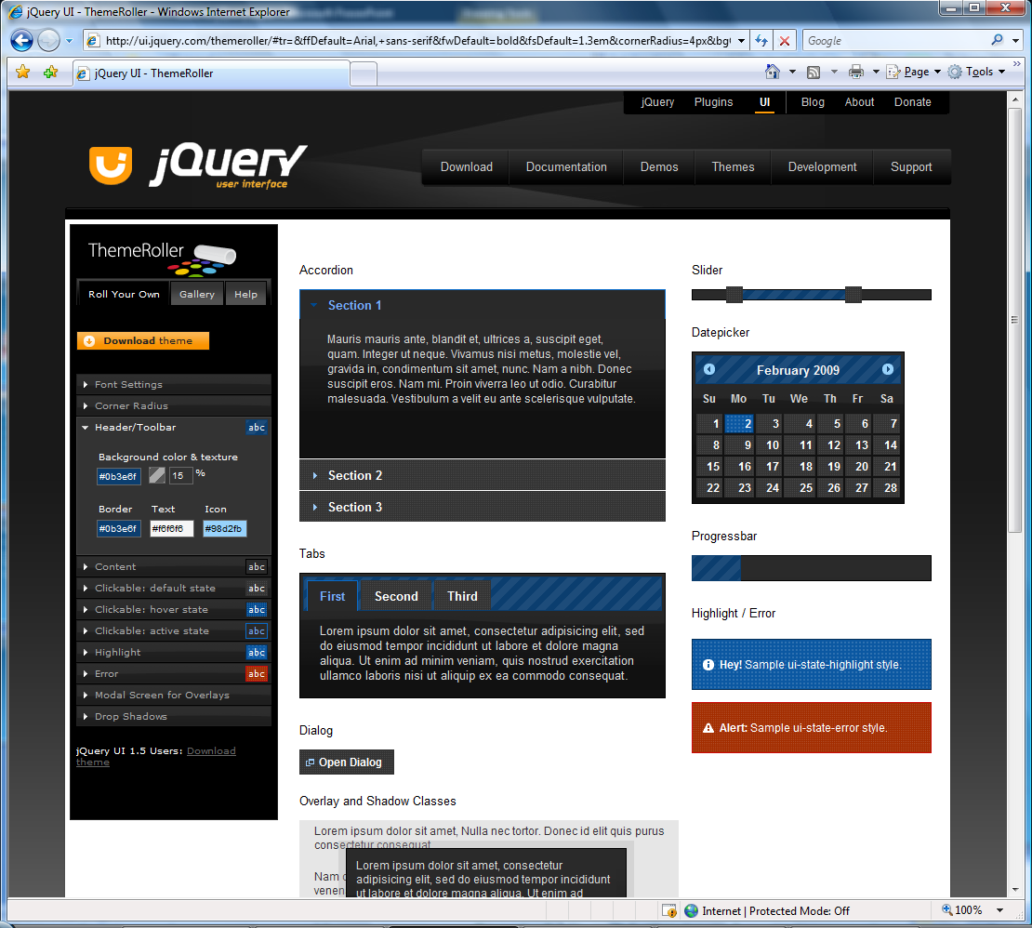
ThemeRoller
jQuery has a very nice CSS Design app for use with their UI Plugins (http://www.themeroller.com)

Slide 15
Getting Started
All you need to get started is the latest jQuery file
Include in your head tag
<script type=“text/javascript” src=“jquery-1.4.2.js”></script>
jQueryUI.com contains a page to download a customizable and minified package.
<script type=“text/javascript” src=“jquery-ui-1.7.2.custom.min.js”>
</script>
<link type=“text/css” rel=“stylesheet” href=“jquery-ui-1.7.2.custom.css” />

Slide 16
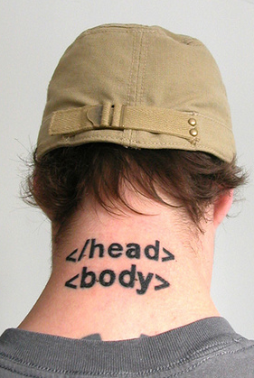
Basic jQuery Demos

Slide 17

RIA Application with jQuery
Automobile Administration Site

Slide 18
Context
Bobby Bolivia’s Used Car Website
Administration Pages Features
  List Automobiles
  Filter
  Delete Automobile

Slide 19
Process
Create Project
Add jQuery-1.4.2.js
Add Reference to Data Model
Add Reference to System.ServiceModel.Web (v3.5)
Setup WCF Service
  Remove system.serviceModel from web.config
  Apply the WebScriptServiceHostFactory
Call $.getJSON

Slide 20
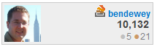
Links
http://jquery.com
http://ui.jquery.com
http://docs.jquery.com
http://api.jquery.com
http://blog.jquery.com
Google – jQuery
StackOverflow.com – jQuery

Slide 21
http://www.agilefirestarter.com
twitter: @agilefire Saturday March 27, 2010

Slide 22
Thank You

