Slide 1
Introduction to the Windows Runtime (WinRT)
Ben Dewey
ben@bendewey.com
Tallan, Inc.
Twitter @bendewey
Notes:
Write blog post ahead?

Slide 2
MARQUEE SPONSOR

Slide 3
PLATINUM SPONSOR

Slide 4

PLATINUM SPONSOR

Slide 5

GOLD SPONSOR

Slide 6

GOLD SPONSOR

Slide 7

GOLD SPONSOR

Slide 8
GOLD SPONSOR

Slide 9

GOLD SPONSOR

Slide 10

GOLD SPONSOR

Slide 11



SILVER SPONSORS

Slide 12
Agenda
What happened at Build?
What is the Windows Runtime
Languages
What wasn’t covered
Questions (if time)
Notes:
What happened at Build? Dev –site 4
What is the Windows Runtime
Took all week to learn
A new API for accessing Windows
What’s in the subset
Languages
Wrapup what wasn’t covered
Async, .NET Framework 4.5 still there, promises and defferals
Questions (if time, otherwise courtyard)

Slide 13
Disclaimer
I’m just one guy talking about pre-beta products

Slide 14




Slide 15
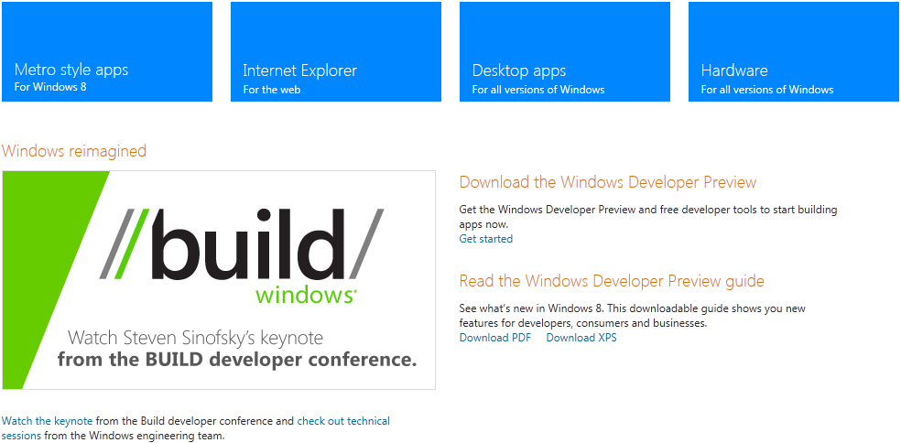
What happened at
Notes:
Audience Questions
Who followed Build
Who watched the keynotes or videos
Anyone writing ‘apps’ for phones or tablets?
Who is a .NET/JS Developer

Slide 16
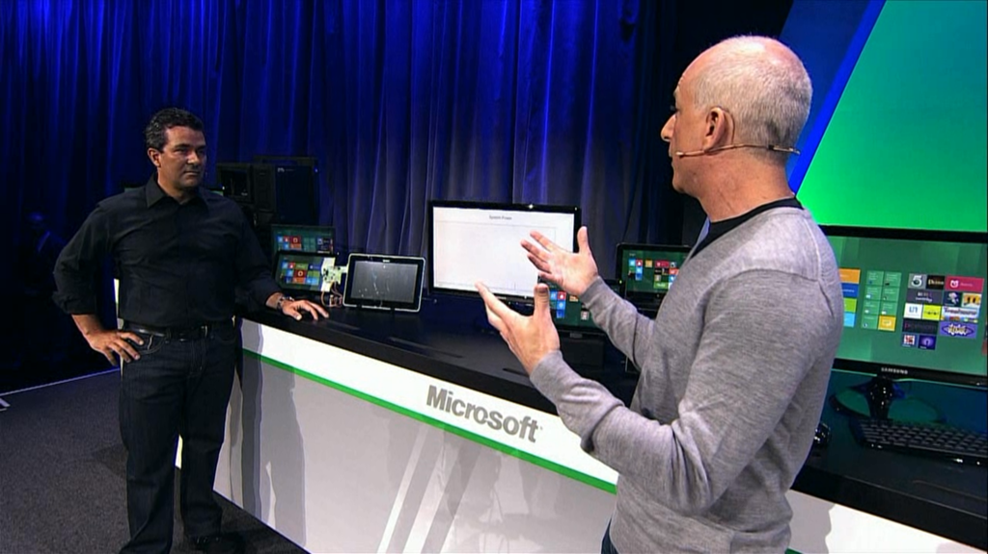
What happened at
Notes:
Windows To Go…

Slide 17
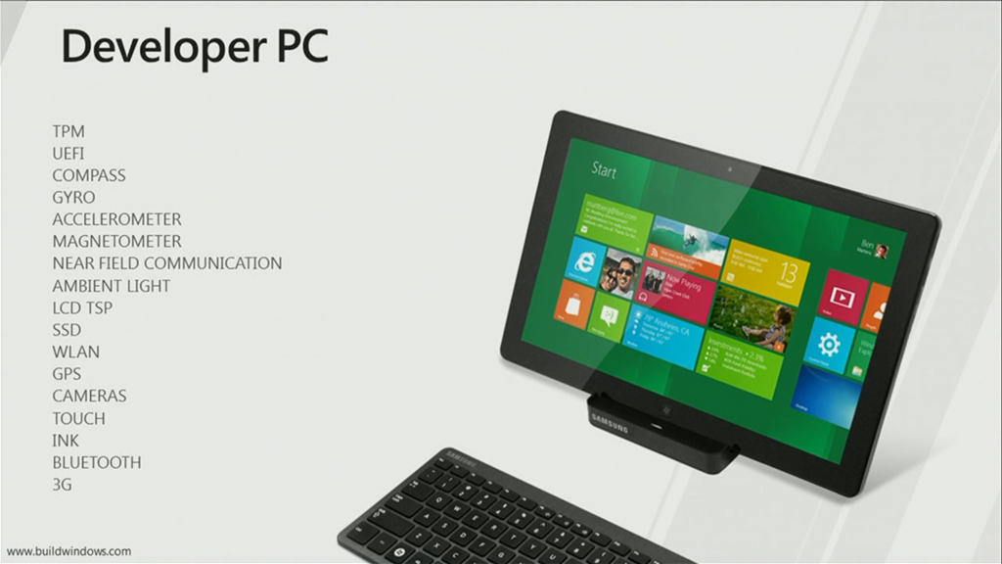
What happened at
Notes:
Audience Questions
Who followed Build
Who watched the keynotes or videos
Anyone writing ‘apps’ for phones or tablets?
Who is a .NET/JS Developer

Slide 18
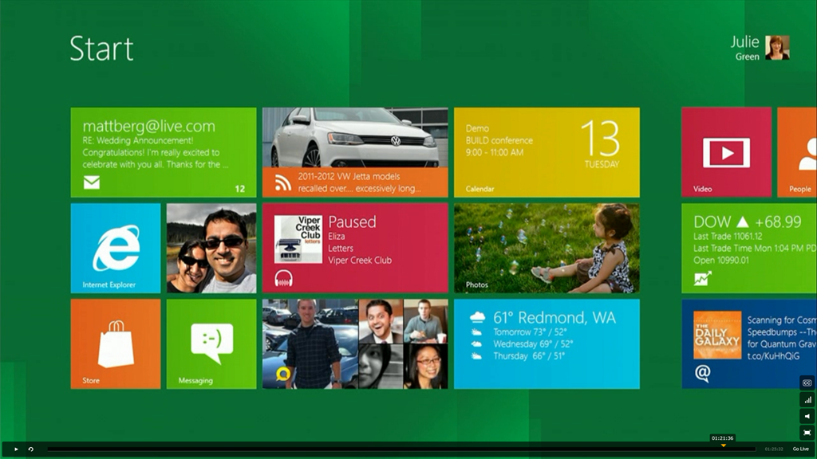
What happened at
Notes:
Audience Questions
Who followed Build
Who watched the keynotes or videos
Anyone writing ‘apps’ for phones or tablets?
Who is a .NET/JS Developer

Slide 19
What happened at
http://dev.windows.com
Notes:
Audience Questions
Who followed Build
Who watched the keynotes or videos
Anyone writing ‘apps’ for phones or tablets?
Who is a .NET/JS Developer

Slide 20
How do you build a Metro style app
The Windows Runtime
A runtime is software designed to support the execution of computer programs written in some computer language.

Slide 21
Windows Runtime Agenda
Demo
What is WinRT
How do I write apps on top of WinRT
  XAML
    C++
    C#, VB, etc
  HTML/CSS
    Javascript
Notes:
This awesome new thing
Sample/demo
Sandboxed/protected/how it runs
Contracts/shares/etc
Com/winrt api/diagrams/architecture/design review
Winrt api as interfaces/projected to language of choice/languages do there thing
.NET profile/async/demo/borrowed ildasm and xaml/etc
C++ (CTR?, CRT?)
HTML/JS/CSS Template
Next wave of apps, nothing can’t be written

Slide 22
Demo
Metro style apps

Slide 23
Motivation (cliché)
Fast and Fluid
Natural and Familiar
Reimagine your application

Slide 24
Motivation (Hidden Meaning)
Fast and Fluid
  No Synchronous I/O Calls
Natural and Familiar
  New APIs to Learn
Reimagine your application
  New Controls, Touch Centric

Slide 25
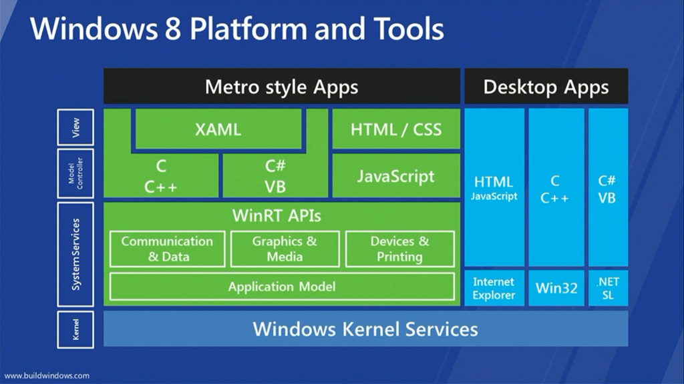

Slide 26
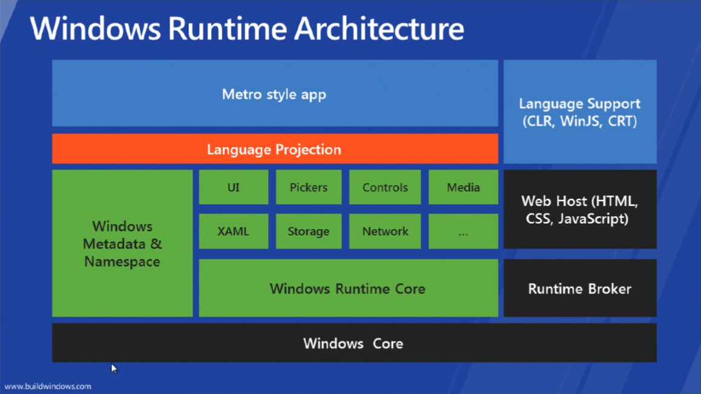
What is WinRT?

Slide 27
Metro style apps (by namespace)
Windows. namespace

Slide 28
The WinRT API
Windows.ApplicationModel
Windows.Data
Windows.Devices
Windows.Foundation
Windows.Globalization
Windows.Graphics
Windows.Management
Windows.Media
Windows.Networking
Windows.Security
Windows.Storage
Windows.System
Windows.UI[.Xaml]
Windows.Web

Slide 29
Language Projections
C++
.NET
JavaScript

Slide 30
C++ Language Improvements
C++ component extensions C++/CX
ABI – Abstract Binary Interface
ref classes (^ the “hat”)
ref new
partial classes
generic types (in addition to templates)
Conversions available between WinRT ABI-safe types and native C++ types

Slide 31
.NET Metro style apps (by namespace)
lang::, Platform::,
collection.h
Windows. namespace

Slide 32
.NET Metro style apps (by namespace)
lang::, Platform::,
collection.h
System. namespace
Windows. namespace

Slide 33
Windows Tailored Profile
System.Collections
System.ComponentModel
System.Diagnostics
System.Dynamic
System.Globalization
System.IO
System.Linq
System.Net
System.Numerics
System.Reflection
System.Resources
System.Runtime
System.Security
System.ServiceModel
System.Text
System.Threading
System.Xml

Slide 34
What’s missing in the Windows Tailored Profile
Enterprise Development
  ASP.NET
  Console
  DirectoryServices
  Windows Forms
  WPF
  WF
Dangerous, obsolete, legacy
Removed duplicates
Removed badly designed APIs

Slide 35
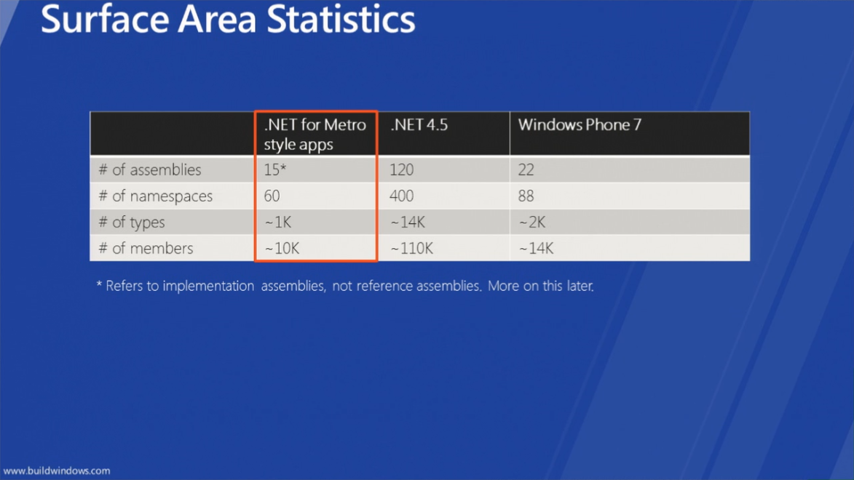
.NET for Metro style apps

Slide 36
Demo
C# metro application

Slide 37
Metro style apps (by namespace)
lang::, Platform::,
collection.h
System. namespace
WinJS. namespace
Windows. namespace

Slide 38
WinJS Namespace
WinJS
WinJS.Application
WinJS.Binding
WinJS.Class
WinJS.Namespace
WinJS.Navigation
WinJS.Resources
WinJS.UI
WinJS.UI.Animation
WinJS.UI.Fragments
WinJS.Utilities

Slide 39
Demo
HTML/Javascript metro application
consuming WinRT components

Slide 40
Rules
API signatures must only use Windows Runtime types or interfaces
Structs can only have public fields
Inheritance can only be used for XAML controls all other types must be sealed
Only supports system provided generic types

Slide 41
What wasn’t covered
  Tiles
  Package Manifest
    Capabilities (System Prompts for user)
    Declarations (Participation in Contracts, etc)
  Windows Store
  Async and Await Keywords
    Promises (in javascript)
    Deferrals (event handlers for async)
  .NET Framework 4.5 (its still there)
  Portable .NET Library Projects (works across all profiles)

Slide 42
Resource Videos
PLAT-874T - Lap around the Windows Runtime
PLAT-875T - Windows Runtime internals: understanding "Hello World“
TOOL-531T - Using WinRT with C#
TOOL-533T - Using WinRT with JS
TOOL-532T - Using WinRT with C++
TOOL-930C - A .NET developer's view of Windows 8 app development
http://channel9.msdn.com/events/BUILD/BUILD2011/{code}

Slide 43
Resources
Dev Center
http://dev.windows.com
Dev Forum
http://forums.dev.windows.com

Slide 44
Questions
Ben Dewey
ben@bendewey.com
Tallan, Inc.
Twitter @bendewey
Notes:
Write blog post ahead?

